Slide 1
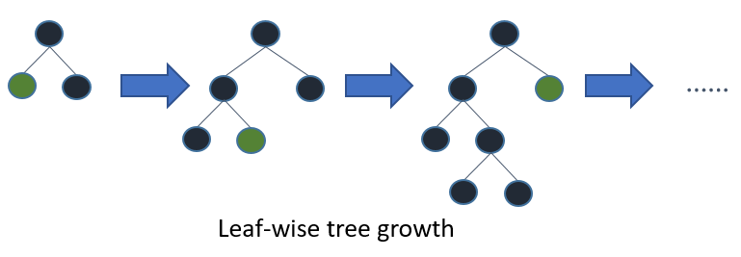
Light Boosting
XG horizontal (level wise) growth
LightGBM (leaf wise) vertical growth which results →More loss reduction higher accuracy

Slide 2
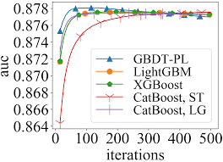

Slide 3
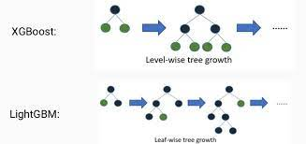
→Lg boosting reduced memory usage compared to other gradient boosting frameworks.

Slide 4
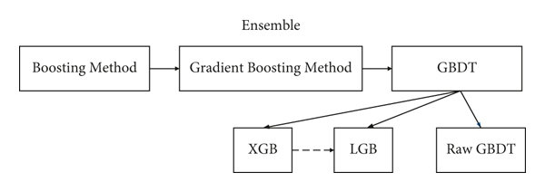

Slide 5
